Slide 1

Machinery and accessories for the food industry
We make the difficult easy
PORTFOLIO IFFA 2025
CRUELLS talleres SL
Pere Llosas 4 • E-17800 OLOT (GI) SPAIN
Tel. +34 972 26 05 31 • Fax +34 972 26 61 54
www.cruells.net • e-mail: cruells@cruells.net

Slide 2
Manual Pneumatics Machines
CRUELLS presents their own Manual Pneumatic Machines for process like Skin stripper removers, gouging, and cutting all type of meats, hams, cheeses, pumpkins, fish, etc.
These light machine weight 1’5kg, which no qualified personnel is required, high performance, and minimal waste.

Slide 3

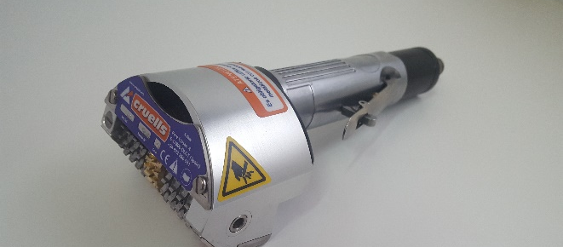
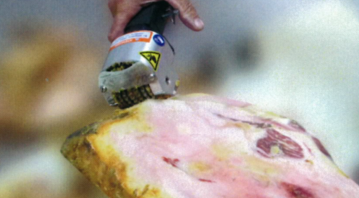
Manual Pneumatics Machines
  SKIN REMOVERS
  Q-72 Skin remover for cured Ham.
  Q-74 Skin remover for fresh Ham.
  Q-52 with a narrower pulling head for difficult areas and reworking.

Slide 4
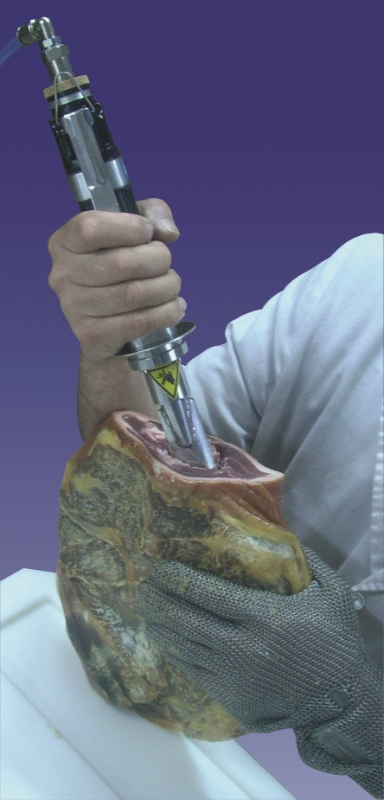
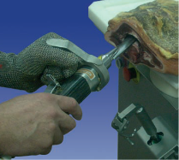
Manual Pneumatics Machines
  GOUGING MACHINE FG
  For deboning meat, hams, cleaning fish, etc.
  Fast and effortless gouging.
  Lightweight (and powerful).
  Very easy to handle.

Slide 5
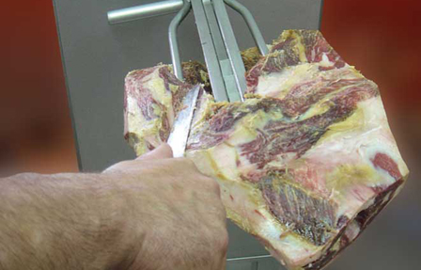
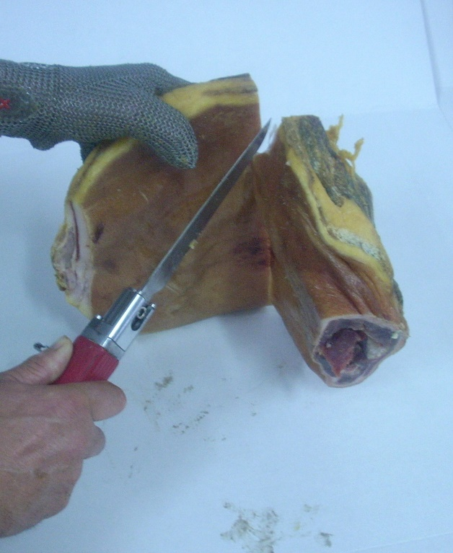
Manual Pneumatics Machines
  PNEUMATIC MANUAL KINFES HC & FCN
  Powerful, light (500gr),fast cutting and easy to manage.
  Versatile, different types of knifes depending on the work.
  Versatility, various types of blades easily changeable for different jobs
  Peeling
  Polishing
  Grating
  Derinding
  Shelling
  Infinite utilities in:
  Slaughterhouses
  Quartering Rooms
  Boning Rooms
  Butchers / Butcheries

Slide 6
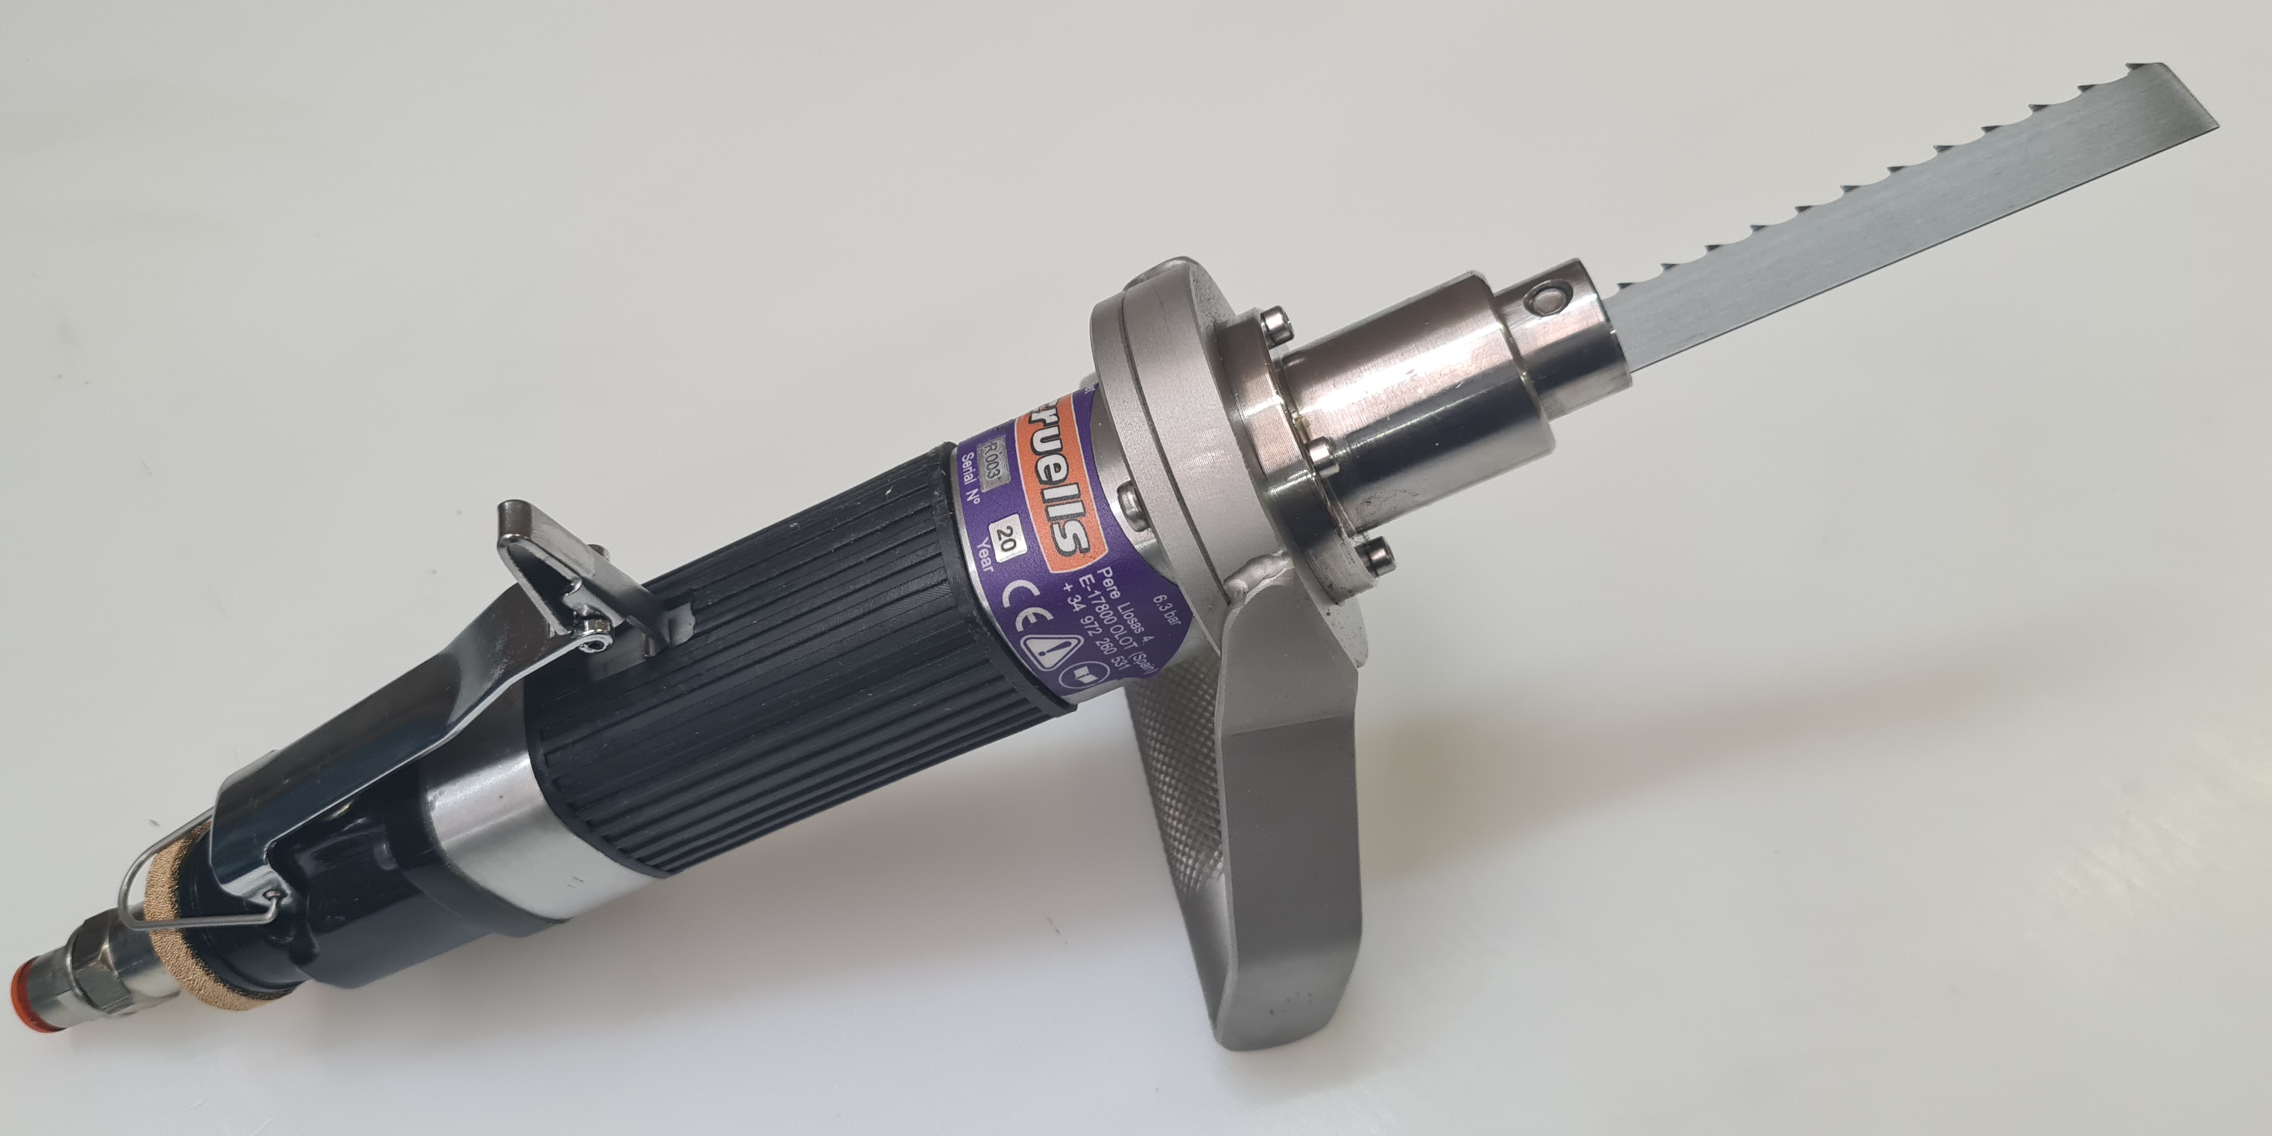
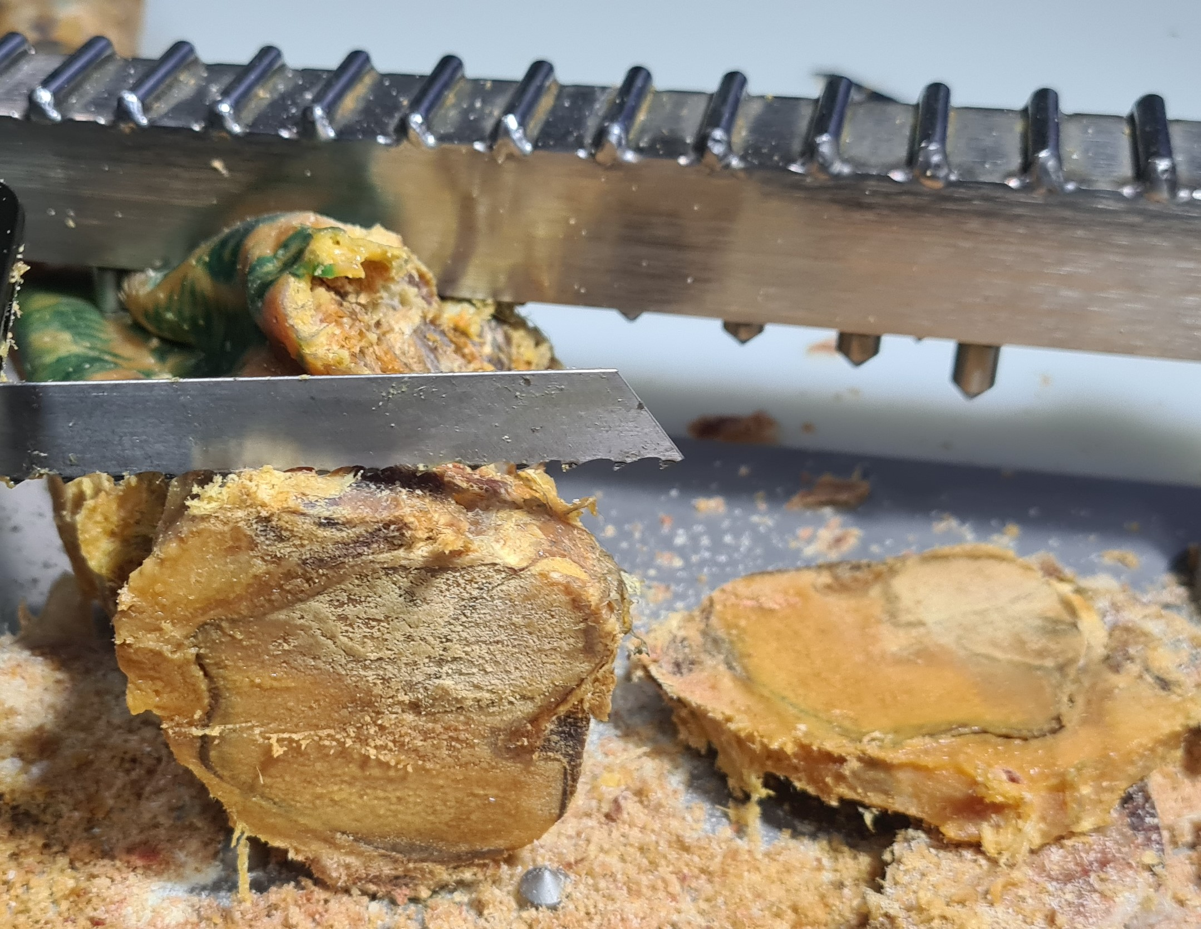
Manual Pneumatics Machines
  PNEUMATIC MANUAL SAW
  Powerful, light (1,3 Kg),fast cutting and easy to manage.
  Versatile, different types of knifes depending on the work.
  Versatility, various types of blades easily changeable for different jobs, especially cutting bones.

Slide 7
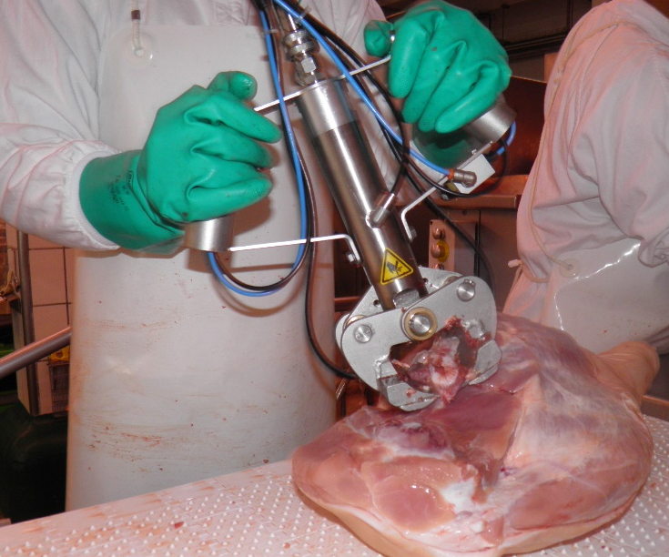
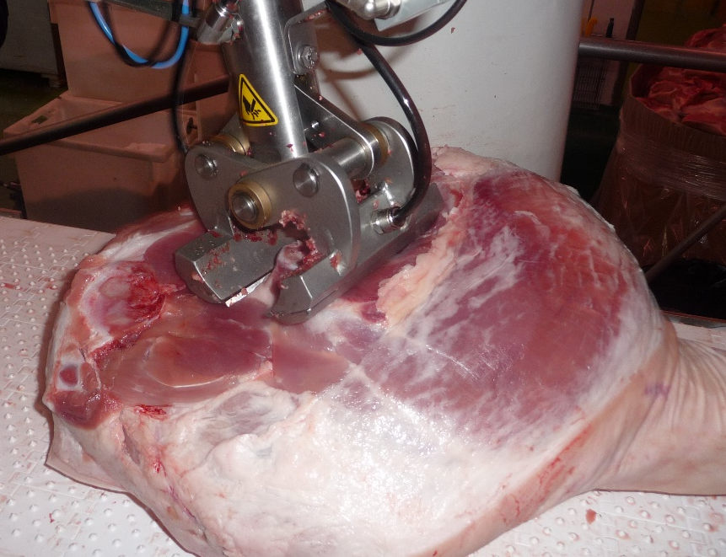
Manual Pneumatics Machines
  PNEUMATIC SHEAR CZ
  Pneumatical shear to cut fresh ham coccyx bones on continuous
  Avoids of parasites and mites' infections.
  Works on continuous feeding, over a belt or table.
  Clean cutting.
  Saves on buttering bones process.
  Efficient and without injury to the worker

Slide 8
Cutting machines/Slicers for slices, cubs, strips
  CRUELLS design and build its own cutting machines. Thanks to a new innovative mechanical system, it has improved their performance and powerful.
  CRUELLS adapt its machines depending on the products to cut and the final size.
  The machines are powered by different electrical engines, and various power ratings of 5HP, 10HP or 15HP.

Slide 9
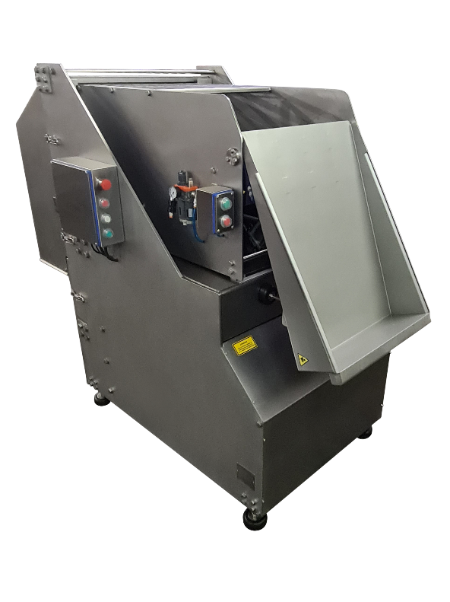
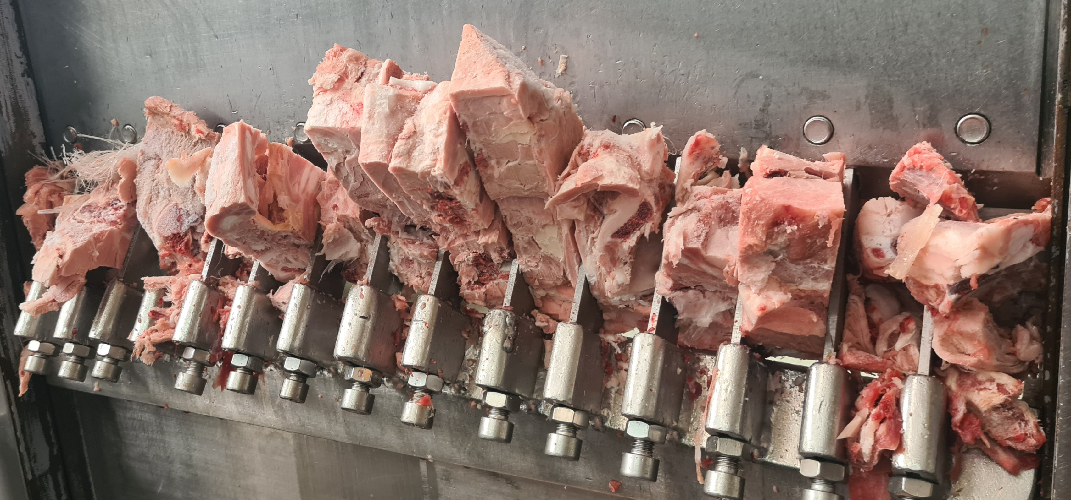
Cutting machines/Slicers for slices, cubs, strips
  CUTTING GUILLOTINE FOR FROZEN MEAT
  Machines designed to cut frozen products blocks into strips or prism shapes for further processing (cutter, chopper, etc.) or just for direct packaging.
  Capacity to admit blocks of up to 25 cm in height x 50 cm in width x 100 cm in length or longer on continuous feeding.
  • The blocks are transformed into prism shapes of 4 x 8,3 cm x the height of the block.
  • Clean cuts without tearing.
  • Easy handling and installation, specialized personnel not necessary.
  • High versatility on removing of blades for sharpening or exchange.
  • Totally built on stainless steel.
  • All parts subjected to a great deal of friction are constructed in special materials, in order to achieve minimal waste and ensure a long life’s machine.
  • The simplicity of the entire mechanism contributes to a high level of reliability.
  • Under request, it can be supplied with smaller prisms shapes, depending on the product to be cut and/or temperature. Furthermore, we can adapt the feeding system.

Slide 10
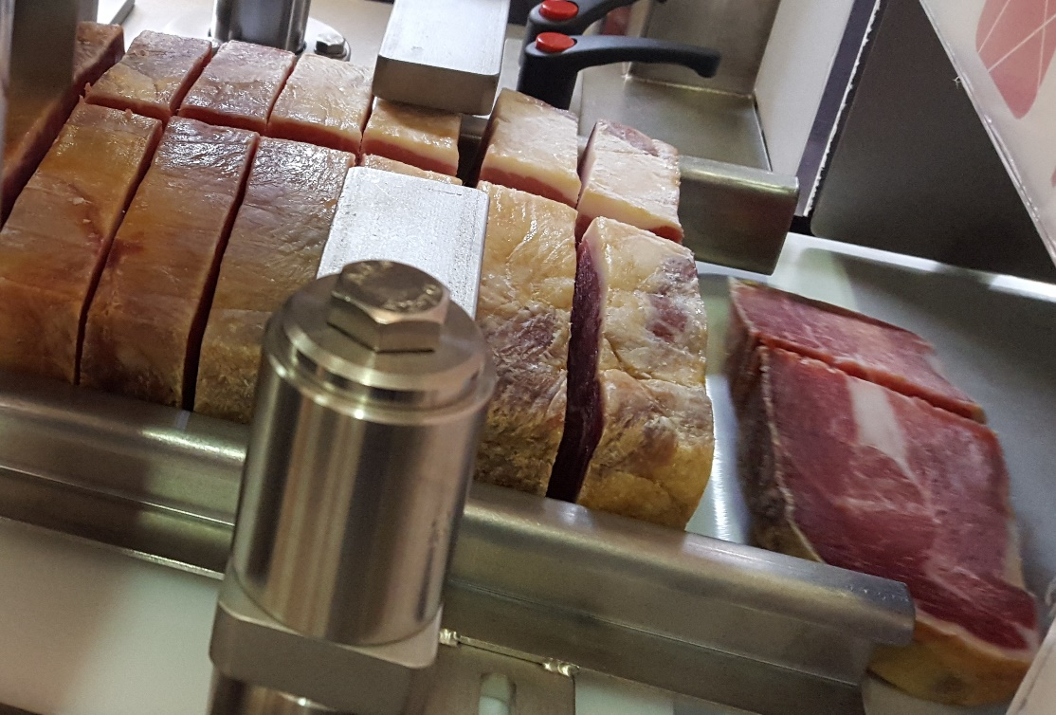
Cutting machines/Slicers for slices, cubs, strips
  SLICERS CUTTING MACHINES
  Machines designed to cut all kind of meat into slices Capacity to admit blocks of up to 25 cm in height x 50 cm in width x 100 cm in length or longer on continuous feeding.
  We adapt depending on pieces to feed and the final size to obtain.
  We can adapt the feeding system.

Slide 11
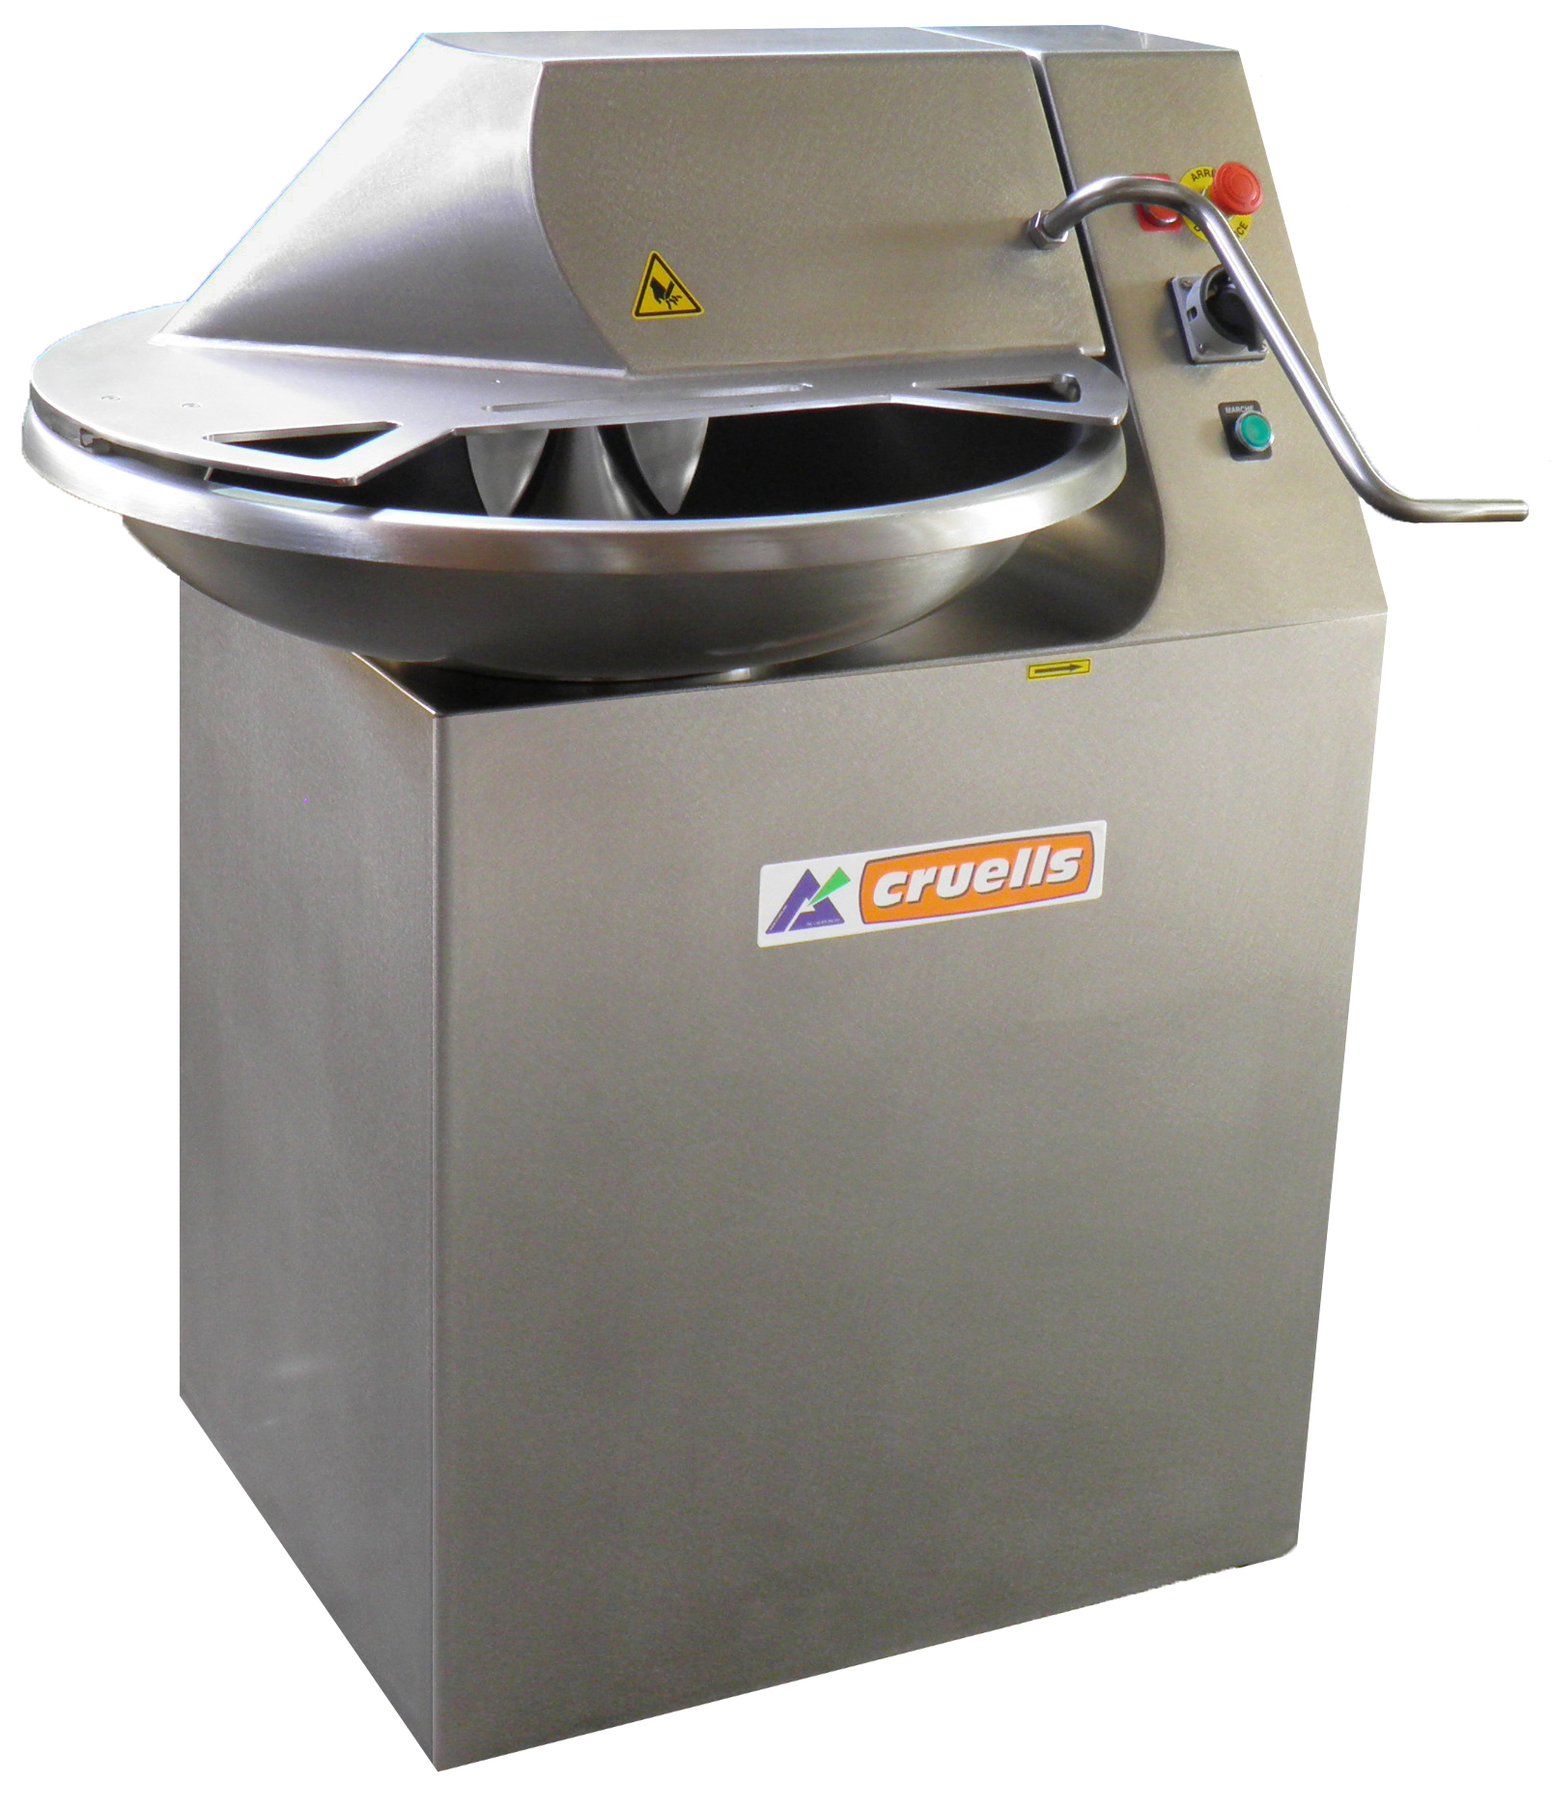
Cutting machines/Slicers for slices, cubs, strips
  CUTTERS
  The CRUELLS Cutter is designed for the most varied sectors of the market.
  Its easy to manage, high performance. It has been designed to help butcher’s, hotels, restaurants, laboratories.
  Built on stainless steel and provided with all security measures, keeping with the EC Norms.
  It’s a highly reliable machine, easy cleaning, and it needs minimum maintenance.
  CRUELLS offers two models which the difference is on tank capacity: 15 and 30 Litres.

Slide 12
Automatic Debonning Machines and Tables
  CRUELLS offers different kind tables and machines, to debone coccyx, humerus, homoplatellar bones.
  On that way, the deboning process becomes an easy and light work, avoiding overexertion of the personnel, and simplifying it.
  Machines are powered electrical and pneumatical.

Slide 13
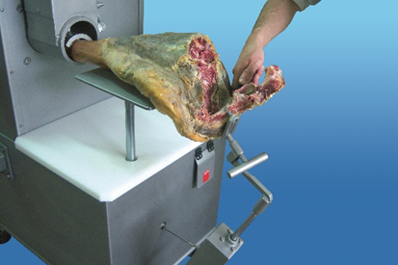
Automatic Debonning Machines and Tables
  HAMS DEBONING MACHINE F-1
  The F-1 ham debone speeds up the deboning process and facilitates tasks such as removing the coccyx bone, polishing, peeling, gouging and finishing deboning.
  Work that can be done by any worker, without the need to be an expert.
  Thanks to this machine and the pneumatic gouging machine, the deboning process becomes a simple and very fast task.
  The Cruells boning machine is versatile, since it accepts hams with or without hoof, with or without skin, cured or fresh.

Slide 14
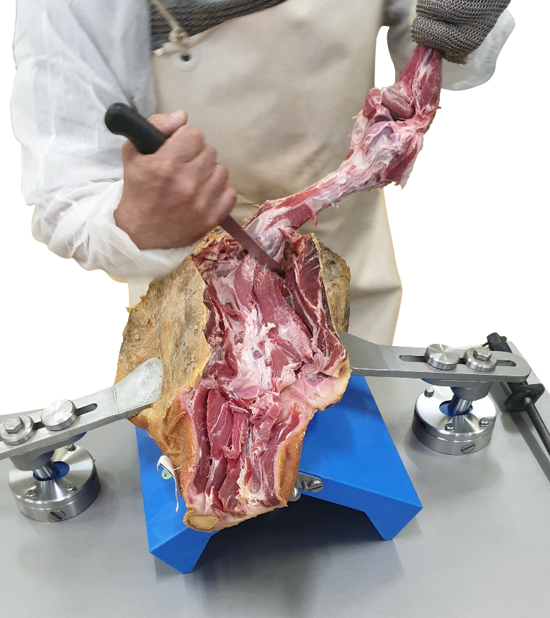
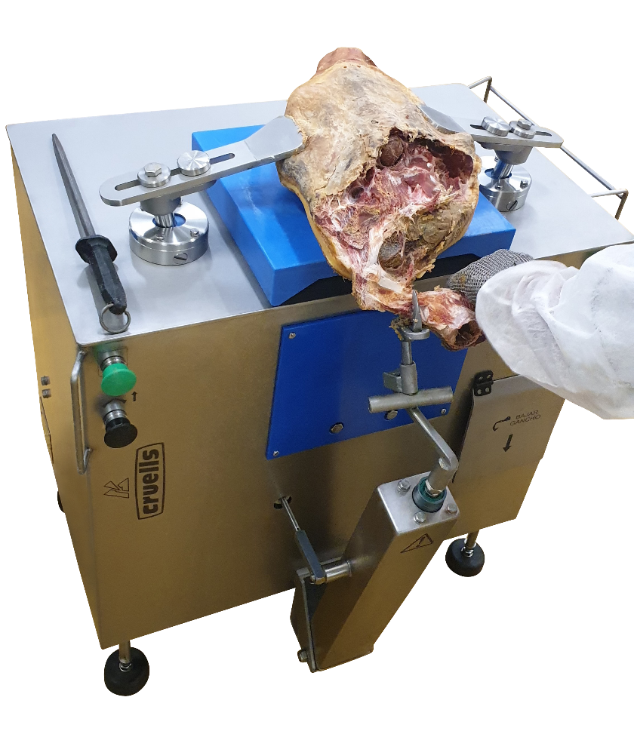
Automatic Debonning Machines and Tables
  HAMS DEBONING OPEN FEMURUS MACHINE F-9V
  The F-9V speeds up the deboning process and facilitates tasks such as removing the femurs bone, polishing, peeling, gouging and finishing deboning.
  Work that can be done by any worker, without the need to be an expert.

Slide 15
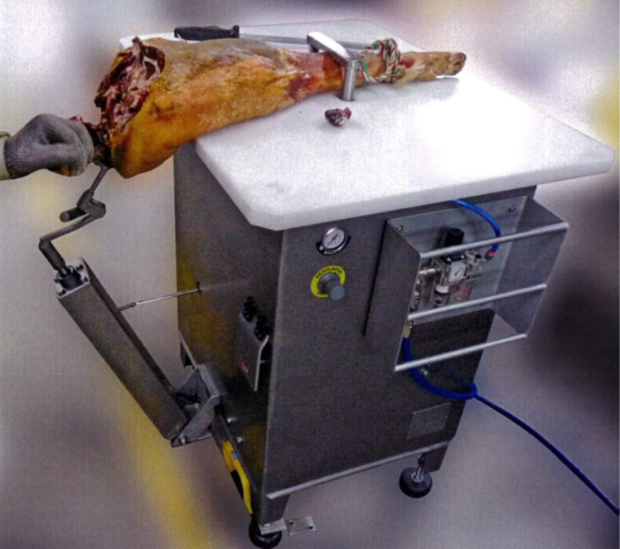
Automatic Debonning Machines and Tables
  HAMS COCCYX DEBONING F-9A
  Facilitates the boning of the coccyx bone or scapula.
  It is also used to finish the boning and peeling process.

Slide 16
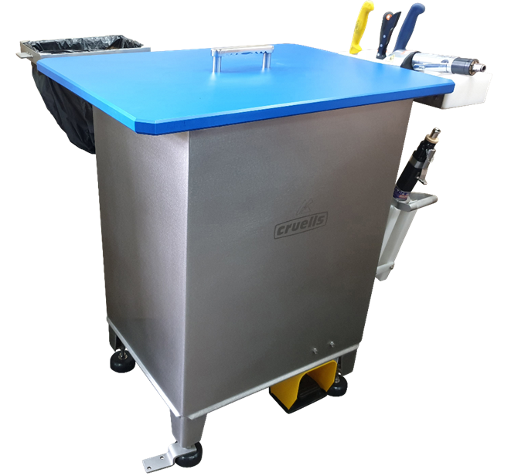
Automatic Debonning Machines and Tables
  HAMS DEBONING PNEUMATIC TABLE F86A
  Pneumatical table for skin remover and deboning processes.
  Pneumatical fixation
  Adjustable height
  Perfect subjection
  High stability

Slide 17
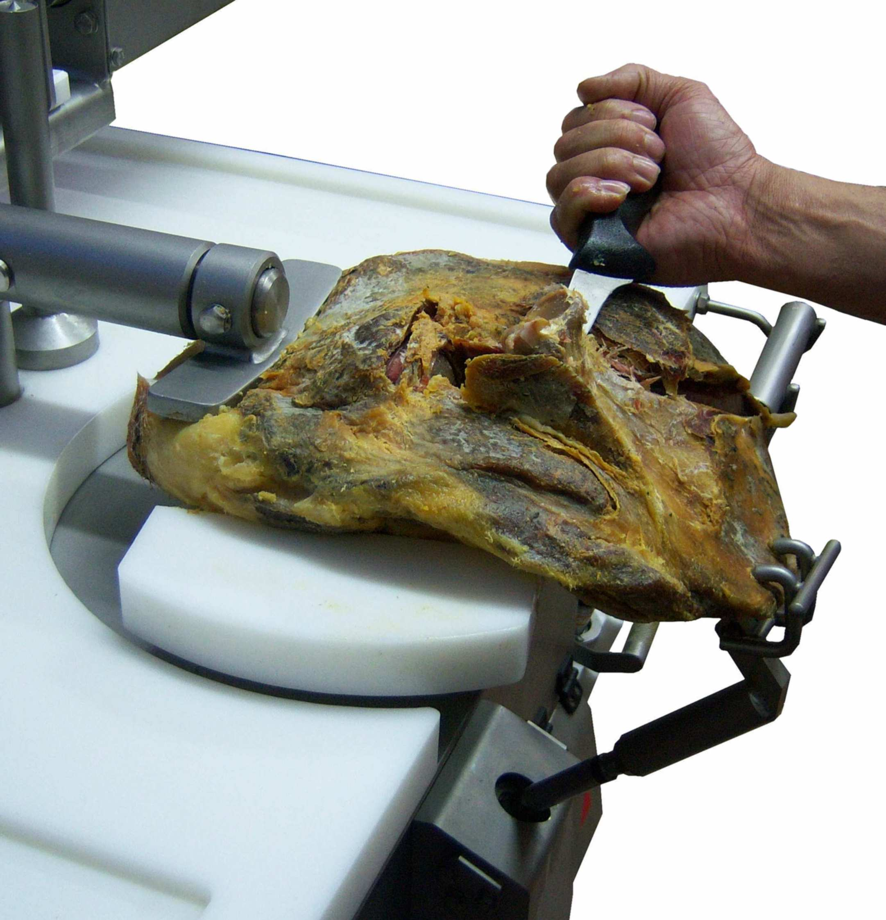
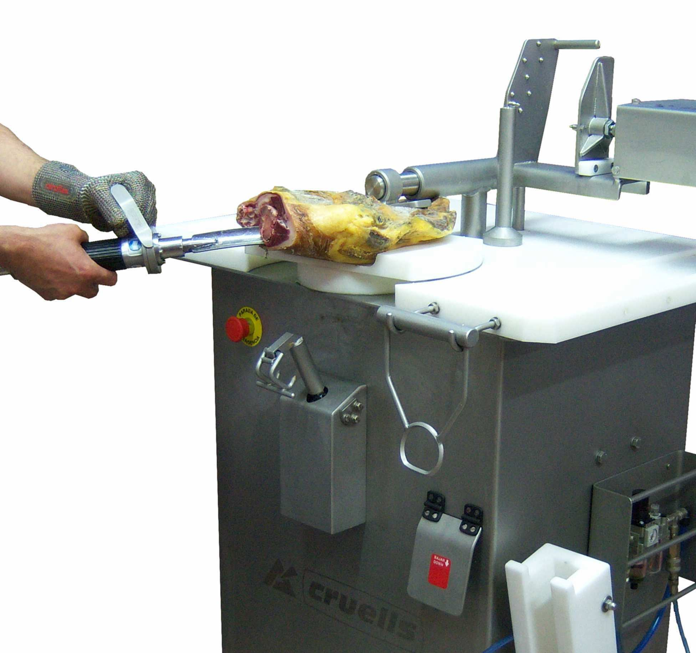
Automatic Debonning Machines and Tables
  HAMS SHOULDER DEBONING DP
  The F-9V ham deboner speeds up the deboning process and facilitates tasks such as removing the femurs bone, polishing, peeling, gouging and finishing deboning.
  Work that can be done by any worker, without the need to be an expert.

Slide 18
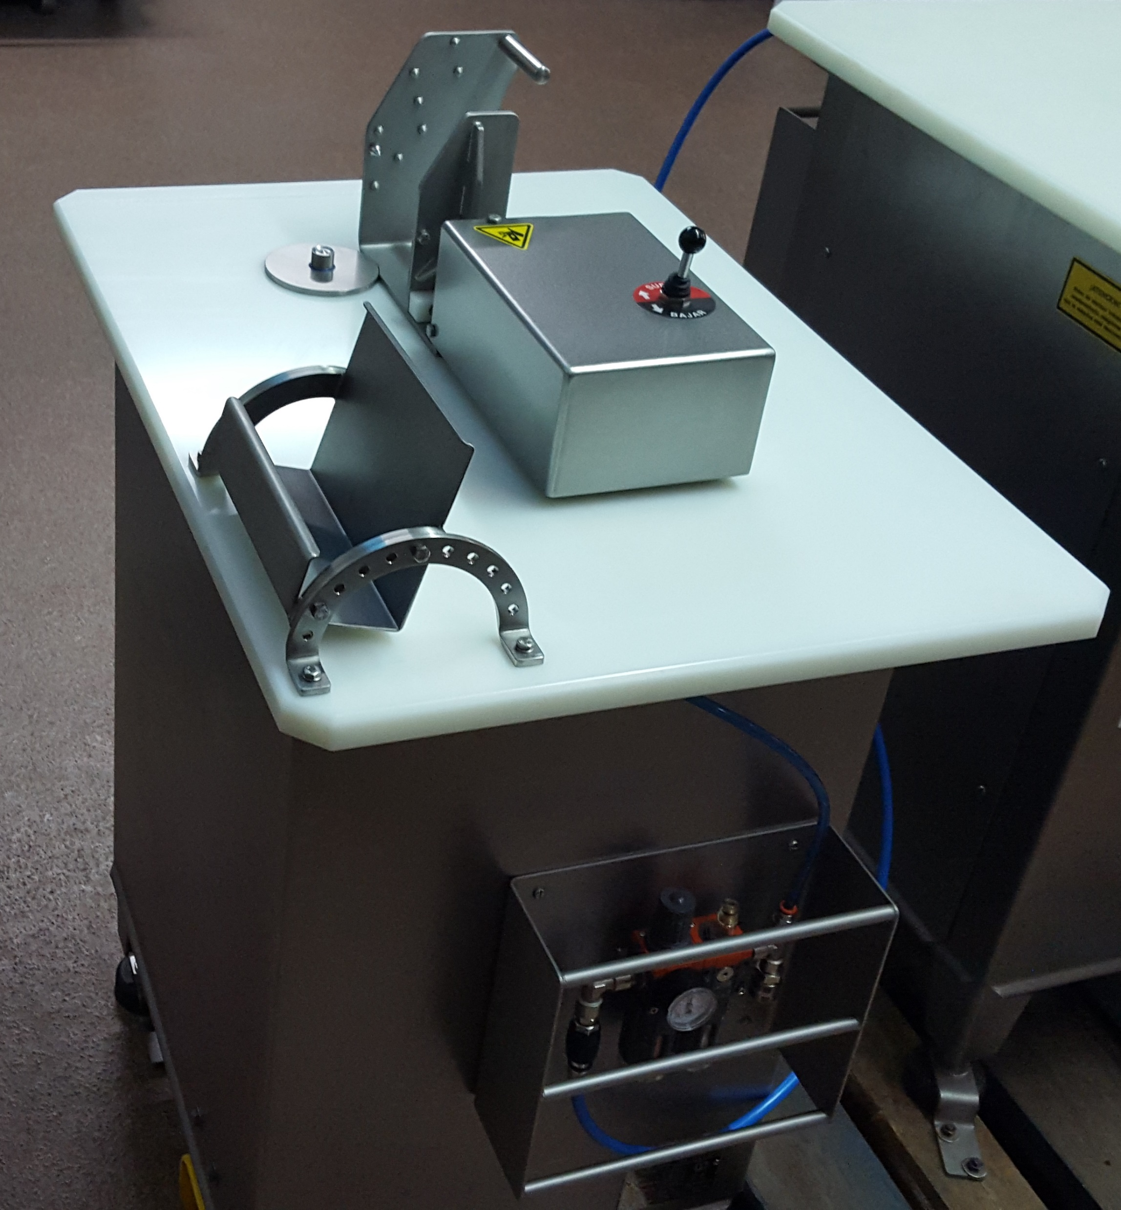
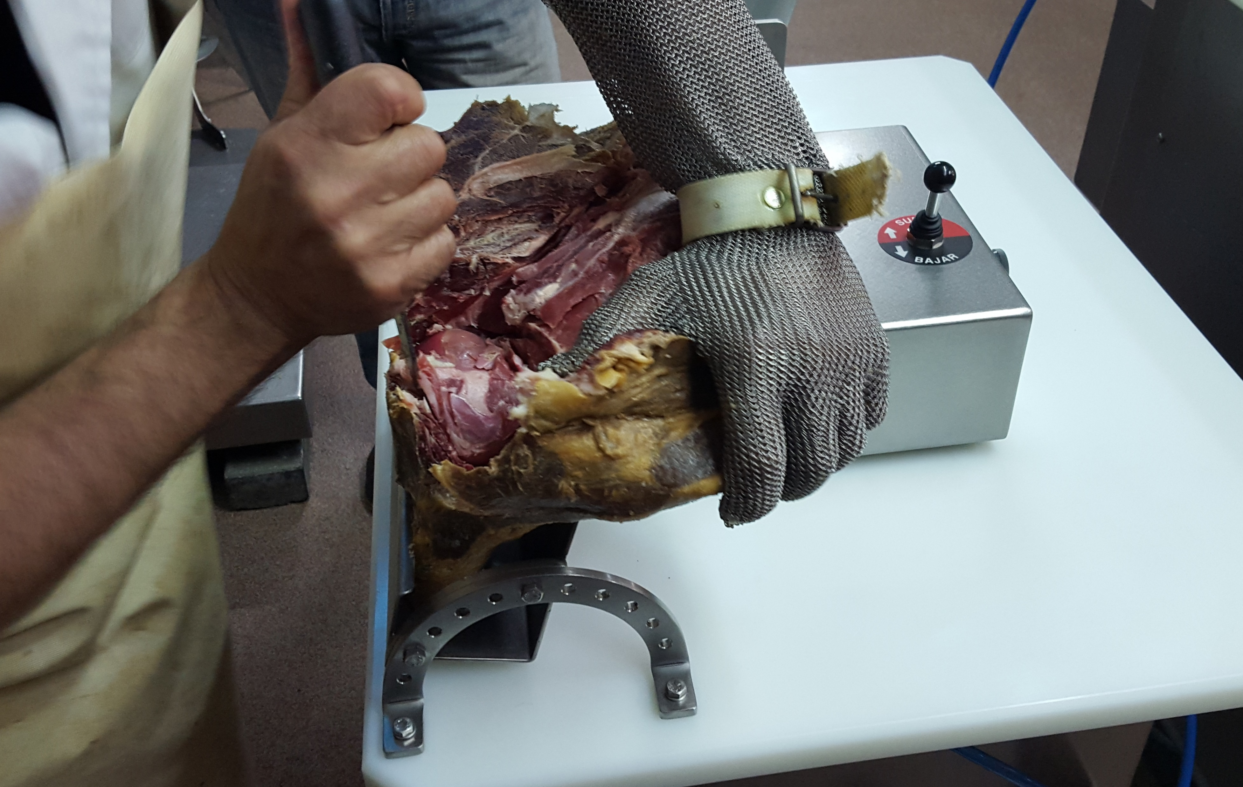
Automatic Debonning Machines and Tables
  HAMS SHOULDER DEBONING F7
  The F7 ham deboner speeds up the deboning process and facilitates tasks such as removing the spatula bone, polishing, peeling, gouging and finishing deboning.
  Work that can be done by any worker, without the need to be an expert.

Slide 19
INNOVATION AND PROJECT DEVELOPMENT
  One of the pillars of CRUELLS' mission is the development of innovation and the continuous improvement of our products and services.
  CRUELLS has always been involved in the improvement of its customers' processes.
  This is why CRUELLS develops new projects thinking on the food process improvements.
  CRUELLS after more than sixty years of experience has developed products and services in the pursuit of innovation

Slide 20
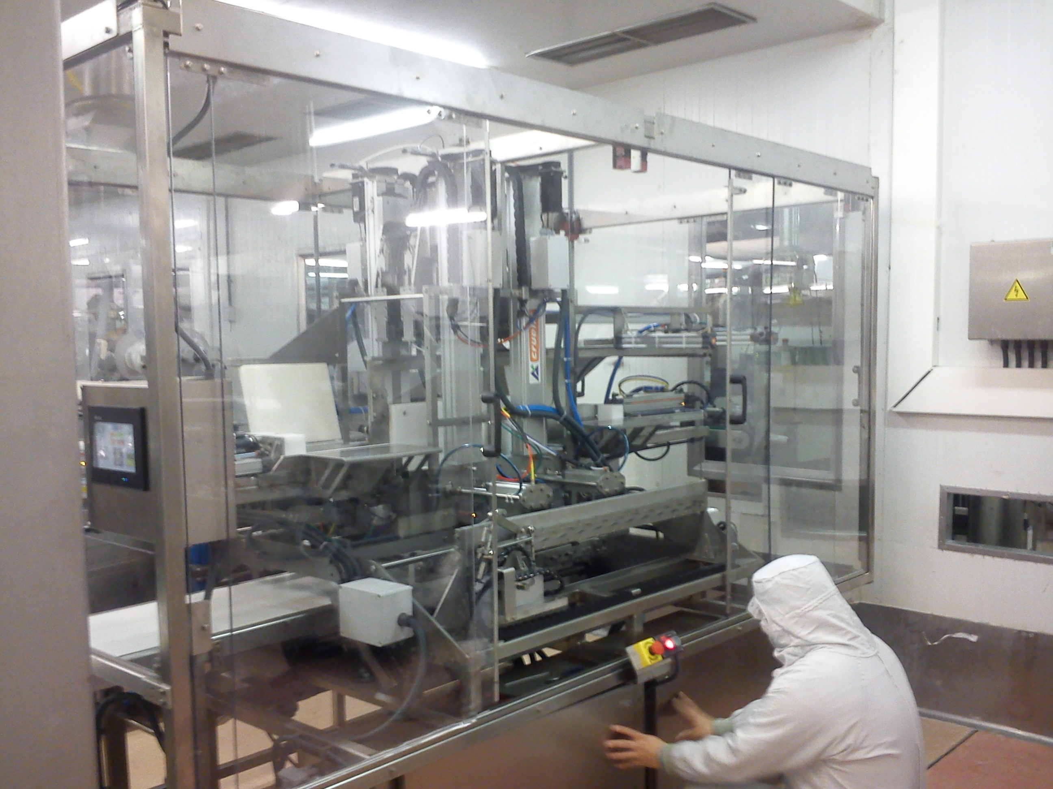
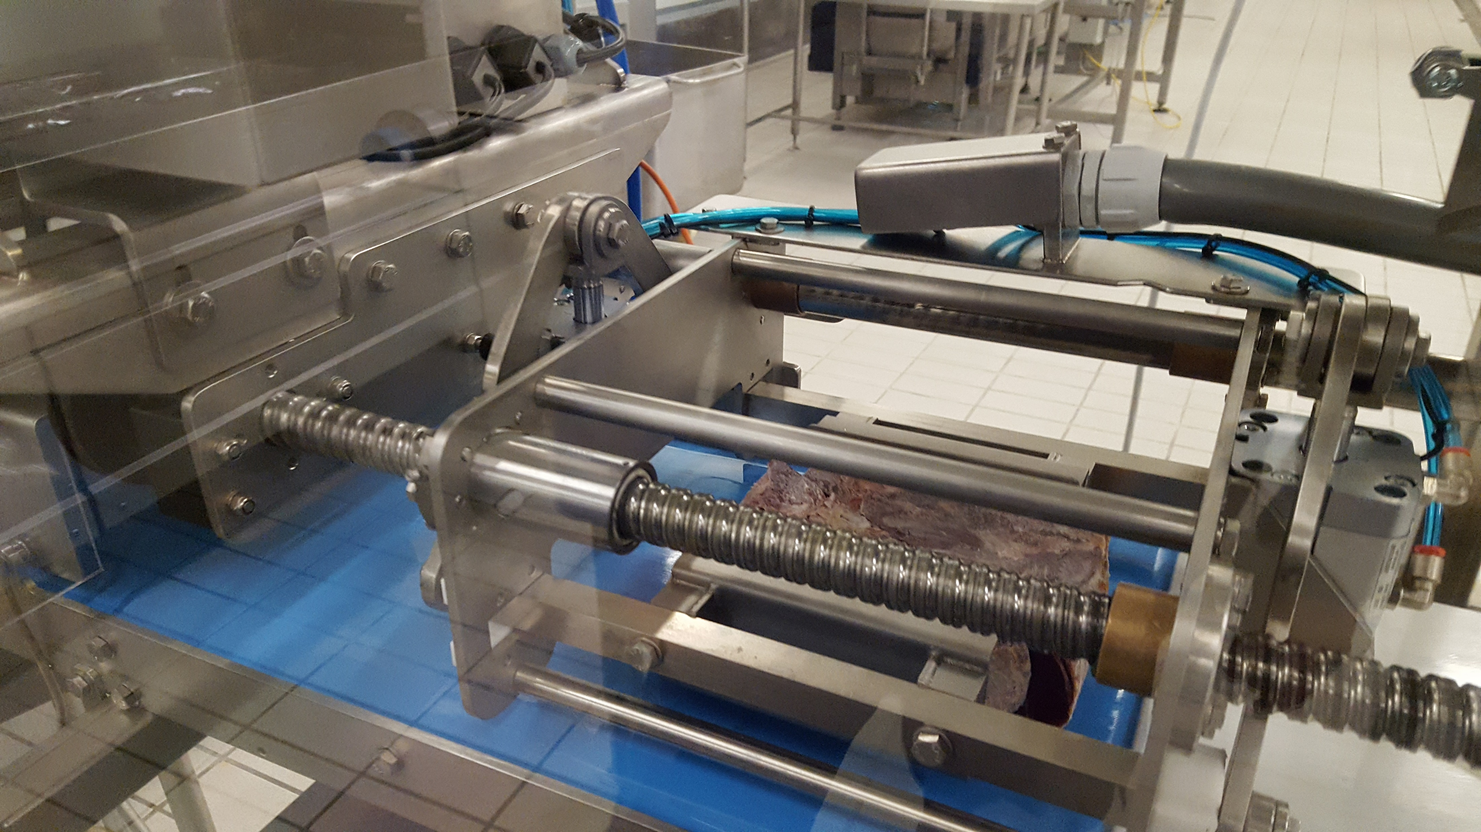
Innovation and Project Development
  PROTYPES FOR OUR CUSTOMERS
  Slicers.
  Packaging lines Feeding

Slide 21
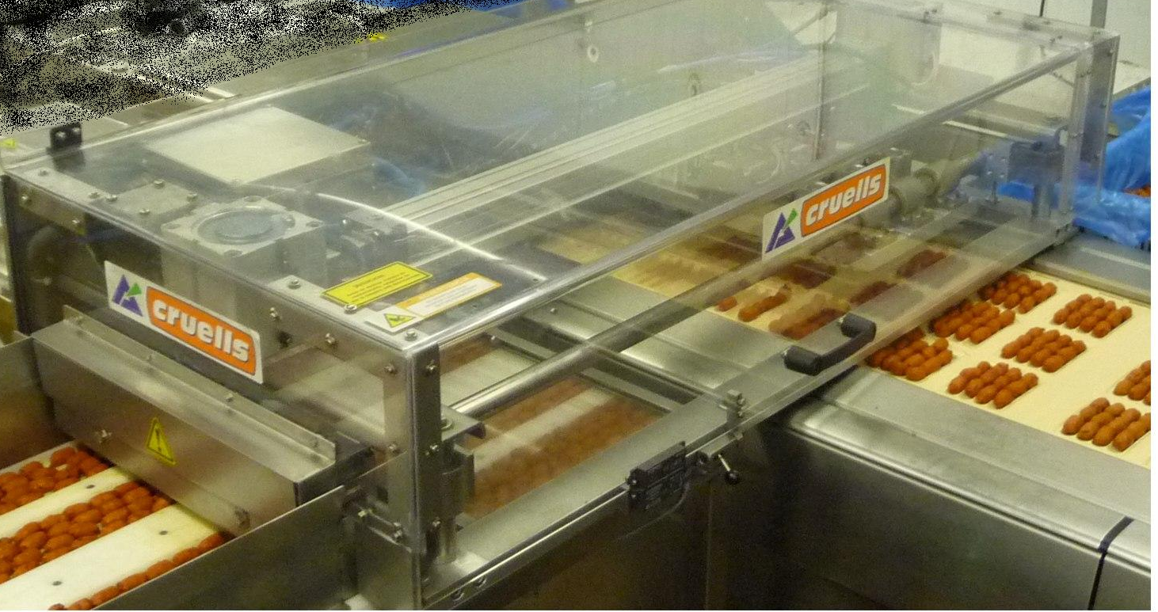
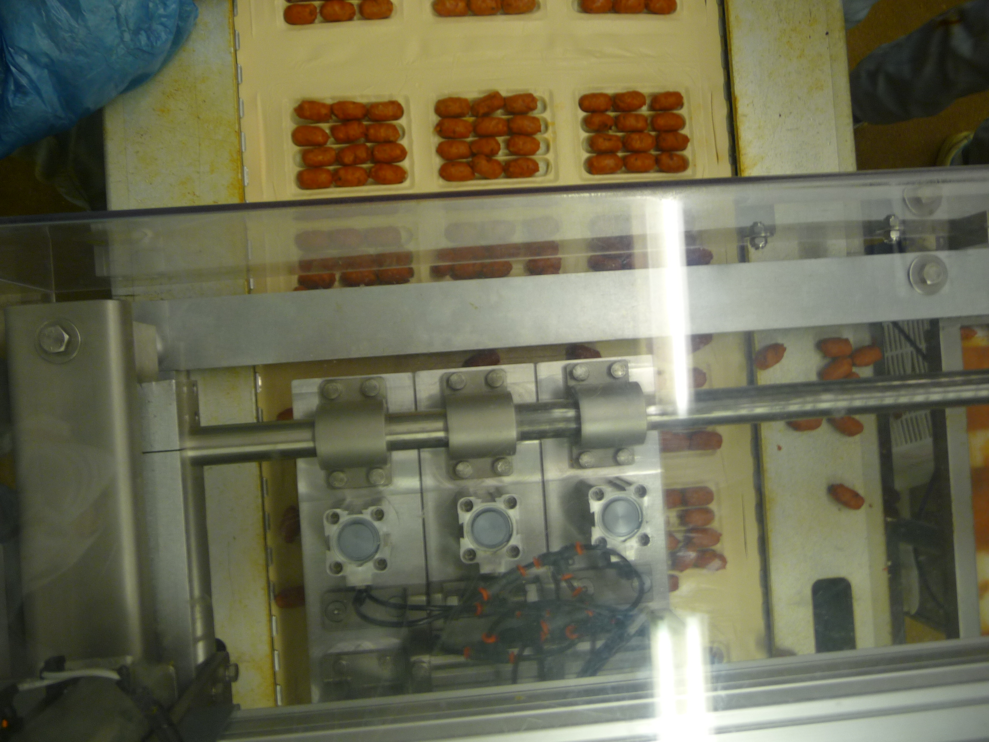
Innovation and Project Development
  PROTYPES FOR OUR CUSTOMERS
  Slicers.
  Packaging lines Feeding

Slide 22
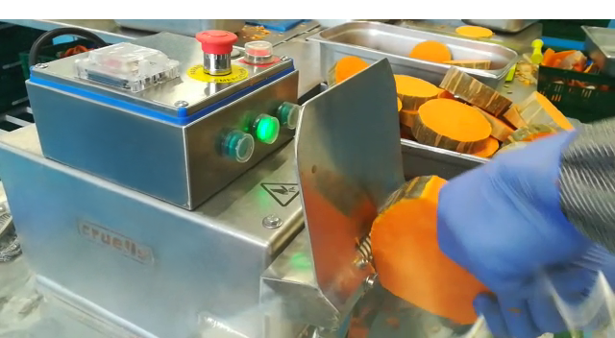
Innovation and Project Development
  ELECTRICAL PUMPKINS SKIN REMOVERS
  Electrical skin remover for pumpkins
  Avoids of parasites and mites' infections.
  Works on continuous feeding, over a belt or table.
  Clean cutting.
  Saves on buttering bones process.
  Efficient and without injury to the worker

Slide 23
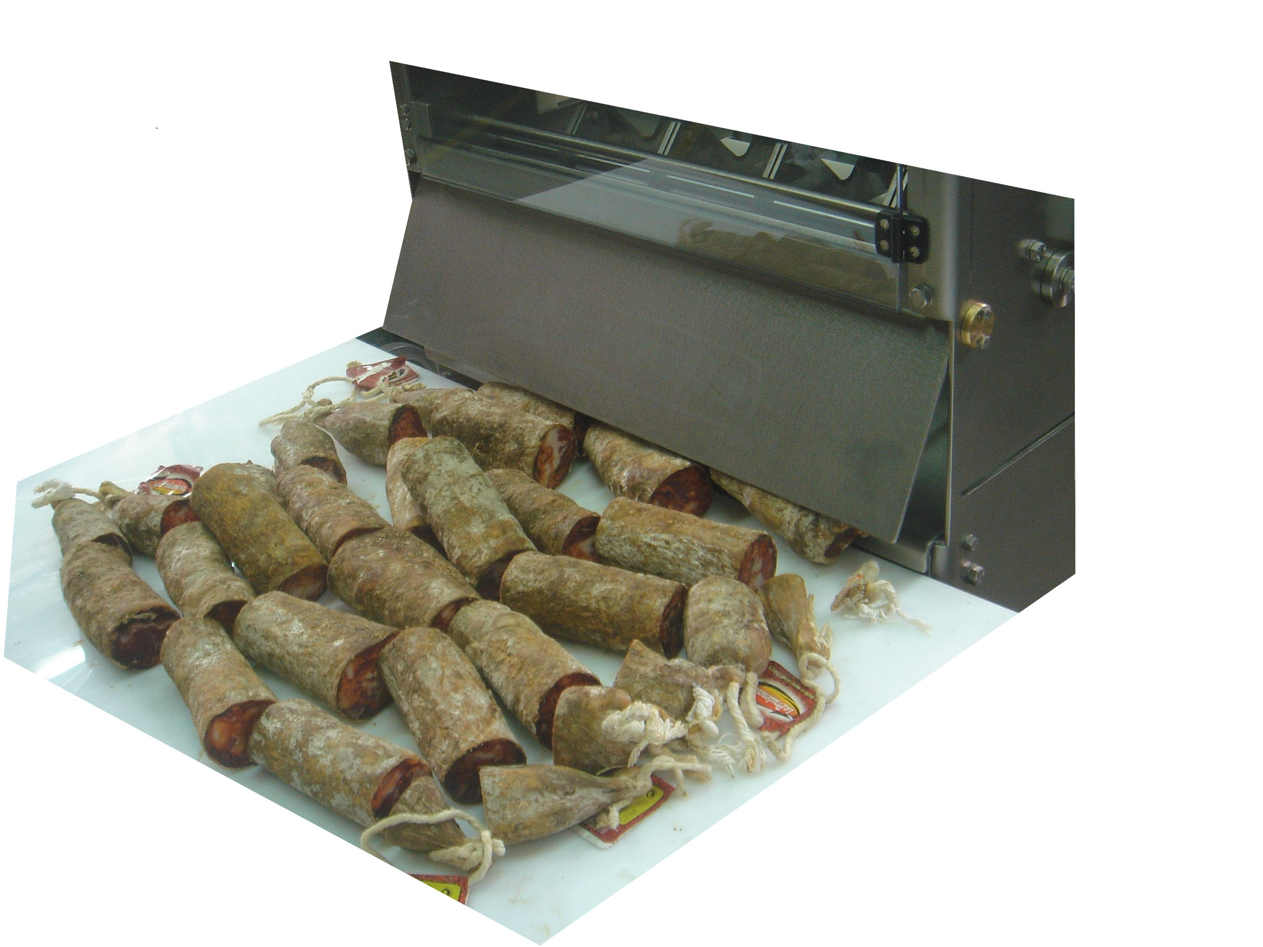
Innovation and Project Development
  SAUSAGE PORTIONING MACHINE WP

Slide 24
Machinery and accessories for the food industry
We make the difficult easy
CRUELLS talleres SL
Pere Llosas 4 • E-17800 OLOT (GI) SPAIN
Tel. +34 972 26 05 31 • Fax +34 972 26 61 54
www.cruells.net • e-mail: cruells@cruells.net

